Slide 1

Discover Kerala
Travel And Tourism Management
Group Members: Akshaya Ashok (12)
Jinsha T C P(27)

Slide 2
CONTENTS
1. Introduction
2. Objectives
3. Features of our system
4. Software and hardware requirements
5. System design and architecture
5.1 Diagrams
5.2 Modules
5.3 Forms
5.4 Tables
6. Sample codes
7. Applications
8. Conclusion

Slide 3
INTRODUCTION
From ancient days people of India beleive in wordict "Adhithi devo bhava" . So we made an effort to prepare an project on ONLINE TOURIST GUIDE.
We provide tourist spots according to travelers choice.
There will be facility to book and access the tourist guide.
Qualified & expierenced guides may register .
We are providing a Google map for the easiness of travelling.
Main users of our site is travelers and guides.

Slide 4
OBJECTIVES
The aim is to provide information about various tour spots such budget travel seashore's,adventure travel,etc.
Tourists or simply the users who like to travel can visit our site to locate their places, from here they get the details about the interesting locations of the place they choose.
The details about various packages which help them to reach their destinations are also provided.
Traveler can choose the guide according to the ratings.

Slide 5
FEATURES
1. Helps in planning and executing a tour
2. Serves a tour guide.
3. Easy to locate places
4. Takes less time consumption
5. Provides Google map
6. User friendly
7. Guides might may register and be booked.
8. View the nearest police station ,traffic center.
9. Helps to reserve affordable hotels & rented vehicles.

Slide 6
SOFTWARE AND HARDWARE REQUIREMENTS
Software Requirements
OS : Windows7 or later
Front End : PHP,HTML
Back End : MySQL, Apache
Text Editor :sublime
Hardware Requirements
  Processor : Having speed of around 1.9GHz
  Memory :500MB
  Hard Disk :2GB
  Display Adaptor : Monitor
  Key Board :102 Keys

Slide 7
SYSTEM DESIGN AND ARCHITECTURE
DIAGRAMS
MODULES
FORMS
TABLES

Slide 8
DIAGRAMS

Slide 9
USE CASE DIAGRAM
ONLINE TOURIST GUIDE
HANDLING REGISTRATION
PROVIDES DETAILS
GRANTING ACCESS PERMISSION
UPDATE INFORMATION
ADMIN
VIEW INFORMATION
REGISTER
USER
PAYMENT

Slide 10
ACTIVITY DIAGRAM
USERS
Can register
Can login
REGISTRATION
REGISTRATION
LOGIN
REGISTERED DETAILS ARE STORED IN DATABASE
REGISTERED USERS CAN LOGIN TO OUR SITE
REGISTER TO OUR WEB SITE

Slide 11
DATA FLOW DIAGRAM
LEVEL 0 DFD
ADMIN
ONLINE TOURIST GUIDE
OUTPUT
USER

Slide 12
LEVEL 1 DFD
LEVEL 1.1 DFD(ADMIN)
MANAGE DATABASE DETAILS ABOUT TOURIST PLACES
ADMIN
LOGIN
MANAGE DETAILS OF REGISTERED USERS

Slide 13
LEVEL 1.2 DFD(USER)
VIEW DETAILS
REGISTER
ONLINE TOURIST GUIDE.
USER
LOGIN

Slide 14
LEVEL 2 DFD
LEVEL 2.1 DFD(ADMIN)
MANAGE DATABASE DETAILS ABOUT TOURIST PLACES
SPOT DETAILS
ADMIN
MANAGE DETAILS OF REGISTERED USERS
USER DETAILS

Slide 15
++
LEVEL 2.2 DFD(USER 1)
REGISTER
USER1 DETAILS
USER1 DETAILS
USER 1
LOGIN
USER 2 DETAILS
VIEW DETAILS

Slide 16
MODULES
REGISTRATION
User registration can done by providing essential details
Only registered user can make the transactions.
SEARCHING
User can search various tour spots that belongs to various places.
MAIN ATTRACTIONS
    Google map is provided to locate the destination.
    Guides might be rated.
    Prefer tour package with a reasonable price.
    Traveler can add the feedback after journey

Slide 17
FORMS
Different forms are there for the users to communicate with our web application.
A home page is there, from there links are given to various other forms like registration form, login form ,thorn tree,spot details etc..

Slide 18

Home Page

Slide 19
Registration Form

Slide 20
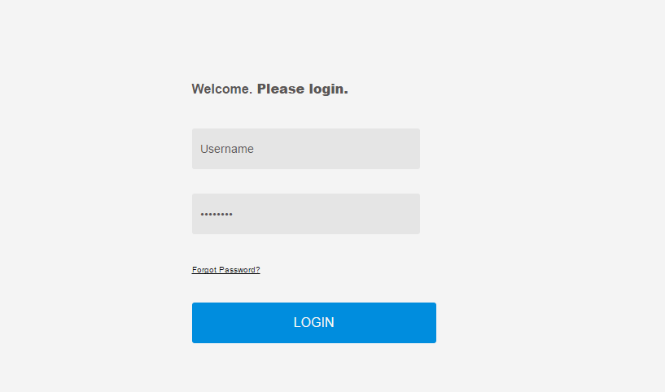
Login Form

Slide 21
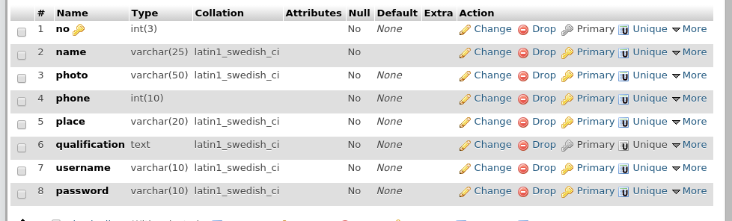
TABLES
REGISTRATION TABLE

Slide 22
DESCRIPTION TABLE

Slide 23

TABLE FOR HERITAGES

Slide 24

TABLE FOR CITY

Slide 25
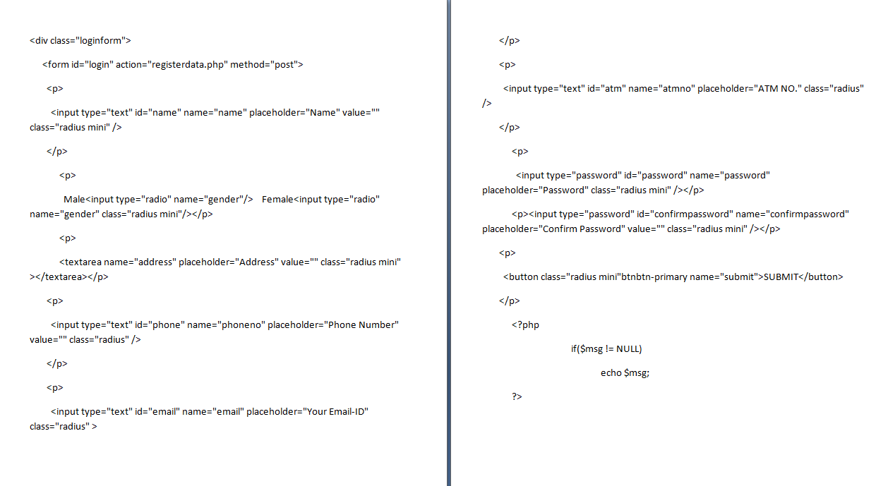
SAMPLE CODES

Slide 26
APPLICATIONS
Our system Discover Kerala serves as a tour guider.
It helps travelers for a safe & comfort journey
Since various tourist plans have been motivated by our govt our site may be an asset.
Our application is feasible to use in the social environment.

Slide 27
CONCLUSION
Our project made us to know about the various technologies that are helpful to us.
This project will be helpful to the persons who likes travelling & exploring.
The effort taken by our group has come to success which gives us much practical knowledge.
The various forms are designed successfully, database creation has completed.

Slide 28
THANK YOU......

